Slide 1
Systems Analysis and Design
Chapter 4-5-6-7
Part – 1
Chapter 4
Requirements Modeling
Khayyam H. MASIYEV
BHOS☺
Information Security Division
Senior Lecturer
khayyam.masiyev@bhos.edu.az

Slide 2
Phase Description
Systems analysis is the second of five phases in the systems development life cycle (SDLC)
Will use requirements modeling, data and process modeling, and object modeling techniques to represent the new system
Will consider various development strategies for the new system, and plan for the transition to systems design tasks

Slide 3
Chapter Objectives
Describe systems analysis phase activities
Explain joint application development (JAD), rapid application development (RAD), and agile methods
Use a functional decomposition diagram (FDD) to model business functions and processes

Slide 4
Chapter Objectives
Describe the Unified Modeling Language (UML) and examples of UML diagrams
List and describe system requirements, including outputs, inputs, processes, performance, and controls
Explain the concept of scalability

Slide 5
Chapter Objectives
Use fact-finding techniques, including interviews, documentation review, observation, questionnaires, sampling, and research
Define total cost of ownership (TCO)
Conduct a successful interview
Develop effective documentation methods to use during systems development

Slide 6
Introduction
This chapter describes requirements modeling techniques and team-based methods that systems analysts use to visualize and document new systems
The chapter then discusses system requirements and fact-finding techniques, which include interviewing, documentation review, observation, surveys and questionnaires, sampling, and research

Slide 7
Systems Analysis Phase Overview
The overall objective of the systems analysis phase is to understand the proposed project, ensure that it will support business requirements, and build a solid foundation for system development
You use models and other documentation tools to visualize and describe the proposed system

Slide 8
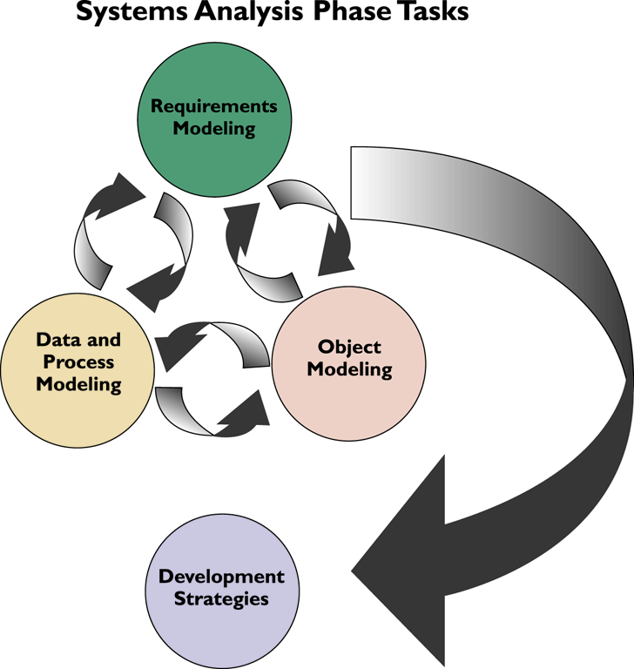
Systems Analysis Phase Overview
Systems Analysis Activities
Requirements modeling
Outputs
Inputs
Processes
Performance
Security

Slide 9
Systems Analysis Phase Overview
Systems Analysis Activities
Data and process modeling
Object Modeling
Development Strategies
System requirements document

Slide 10
Systems Analysis Phase Overview
Systems Analysis Skills
Analytical skills
Interpersonal skills
Team-Oriented Methods and Techniques
Joint application development (JAD)
Rapid application development (RAD)
Agile methods

Slide 11
Joint Application Development
User Involvement
Users have a vital stake in an information system and they should participate fully
Successful systems must be user-oriented, and users need to be involved
One popular strategy for user involvement is a JAD team approach

Slide 12
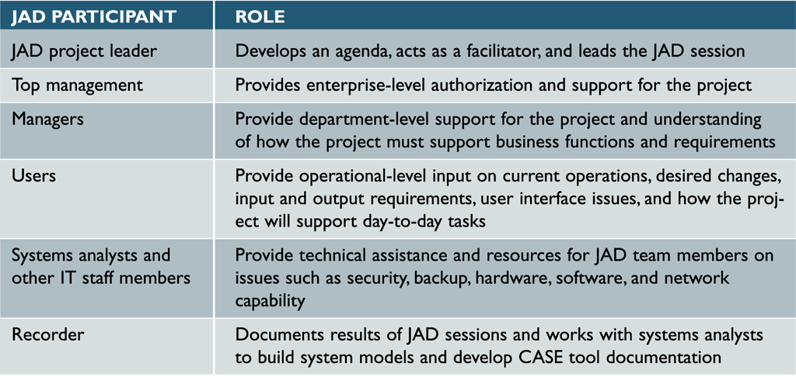
Joint Application Development
JAD Participants and Roles

Slide 13
Joint Application Development
JAD Advantages and Disadvantages
More expensive and can be cumbersome if the group is too large relative to the size of the project
Allows key users to participate effectively
When properly used, JAD can result in a more accurate statement of system requirements, a better understanding of common goals, and a stronger commitment to the success of the new system

Slide 14
Rapid Application Development
Is a team-based technique that speeds up information systems development and produces a functioning information system
Relies heavily on prototyping and user involvement
Interactive process continues until the system is completely developed and users are satisfied

Slide 15
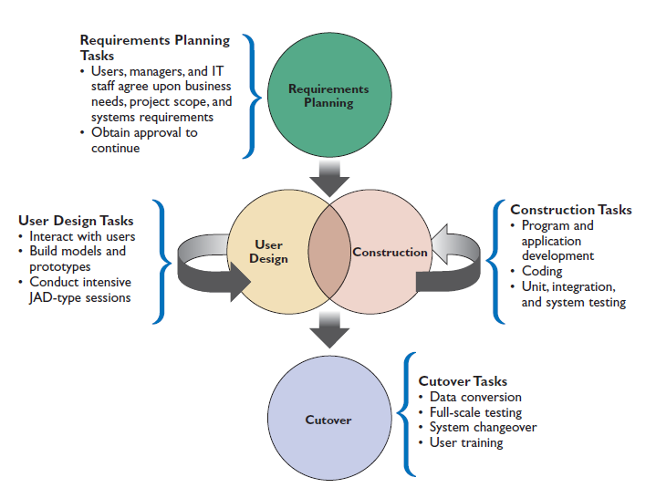
Rapid Application Development
RAD Phases and Activities

Slide 16
Rapid Application Development
RAD Objectives
To cut development time and expense by involving the users in every phase of systems development
Successful RAD team must have IT resources, skills, and management support
Helps a development team design a system that requires a highly interactive or complex user interface

Slide 17
Rapid Application Development
RAD Advantages and Disadvantages
Systems can be developed more quickly with significant cost savings
RAD stresses the mechanics of the system itself and does not emphasize the company’s strategic business needs
Might allow less time to develop quality, consistency, and design standards

Slide 18
Agile Methods
Attempt to develop a system incrementally
Agilian modeling toolset includes support for many modeling tools
Some agile developers prefer not to use CASE tools at all, and rely instead on whiteboard displays and arrangements of movable sticky notes

Slide 19
Agile Methods
Scrum is a rugby term
Pigs include the product owner, the facilitator, and the development team; while the chickens include users, other stakeholders, and managers
Scrum sessions have specific guidelines that emphasize time blocks, interaction, and team-based activities that result in deliverable software

Slide 20
Agile Methods
Agile Method Advantages and Disadvantages
Are very flexible and efficient in dealing with change
Frequent deliverables constantly validate the project and reduce risk
Team members need a high level of technical and interpersonal skills
May be subject to significant change in scope

Slide 21
Modeling Tools and Techniques
Involves graphical methods and nontechnical language that represent the system at various stages of development
Can use various tools
Functional Decomposition Diagrams
Functional decomposition diagram (FDD)
Model business functions and show how they are organized into lower-level processes

Slide 22
Modeling Tools and Techniques
Business Process Modeling
Business process model (BPM)
Business process modeling notation (BPMN)
Pool
Swim lanes

Slide 23
Modeling Tools and Techniques
Data Flow Diagrams
Data flow diagram (DFD)
show how the system stores, processes, and transforms data
Additional levels of information and detail are depicted in other, related DFDs

Slide 24
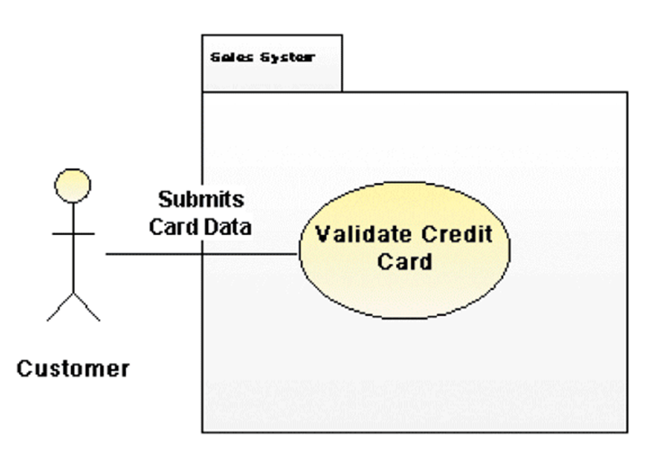
Modeling Tools and Techniques
Unified Modeling Language
Widely used method of visualizing and documenting software systems design
Use case diagrams
Actor
Sequence diagrams

Slide 25
System Requirements Checklist
Outputs
The Web site must report online volume statistics every four hours, and hourly during peak periods
The inventory system must produce a daily report showing the part number, description, quantity on hand, quantity allocated, quantity available, and unit cost of all sorted by part number

Slide 26
System Requirements Checklist
Inputs
Manufacturing employees must swipe their ID cards into online data collection terminals that record labor costs and calculate production efficiency
The department head must enter overtime hours on a separate screen

Slide 27
System Requirements Checklist
Processes
The student records system must calculate the GPA at the end of each semester
As the final step in year-end processing, the payroll system must update employee salaries, bonuses, and benefits and produce tax data required by the IRS

Slide 28
System Requirements Checklist
Performance
The system must support 25 users online simultaneously
Response time must not exceed four seconds

Slide 29
System Requirements Checklist
Controls
The system must provide logon security at the operating system level and at the application level
An employee record must be added, changed, or deleted only by a member of the human resources department

Slide 30
Future Growth, Costs, and Benefits
Scalability
A scalable system offers a better return on the initial investment
To evaluate scalability, you need information about projected future volume for all outputs, inputs, and processes

Slide 31

Future Growth, Costs, and Benefits
Total Cost of Ownership
Total cost of ownership (TCO) is especially important if the development team is evaluating several alternatives
One problem is that cost estimates tend to understate indirect costs
Rapid Economic Justification (REJ)

Slide 32
Fact-Finding
Fact-Finding Overview
First, you must identify the information you need
Develop a fact-finding plan
Who, What, Where, When, How, and Why?
Difference between asking what is being done and what could or should be done

Slide 33
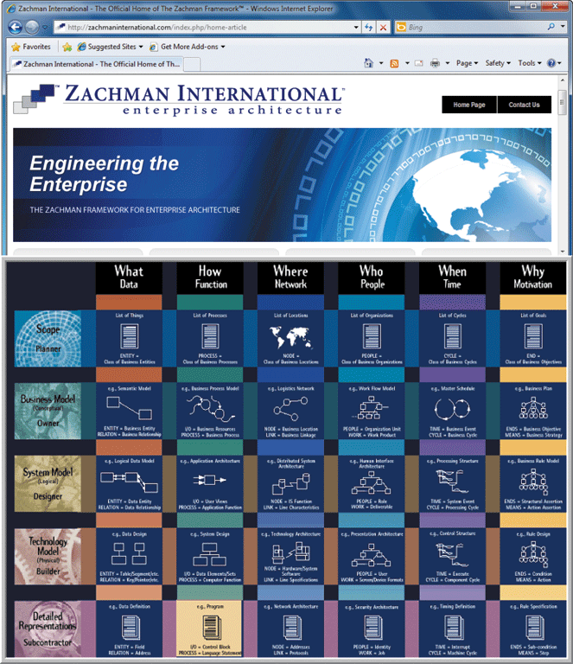
Fact-Finding
The Zachman Framework
Zachman Framework for Enterprise Architecture
Helps managers and users understand the model and assures that overall business goals translate into successful IT projects

Slide 34

Interviews
Step 1: Determine the People to Interview
Informal structures
Step 2: Establish Objectives for the Interview
Determine the general areas to be discussed
List the facts you want to gather

Slide 35
Interviews
Step 3: Develop Interview Questions
Creating a standard list of interview questions helps to keep you on track and avoid unnecessary tangents
Avoid leading questions
Open-ended questions
Closed-ended questions
Range-of-response questions

Slide 36
Interviews
Step 4: Prepare for the Interview
Careful preparation is essential because an interview is an important meeting and not just a casual chat
Limit the interview to no more than one hour
Send a list of topics
Ask the interviewee to have samples available

Slide 37
Interviews
Step 5: Conduct the Interview
Develop a specific plan for the meeting
Begin by introducing yourself, describing the project, and explaining your interview objectives
Engaged listening
Allow the person enough time to think about the question
After an interview, you should summarize the session and seek a confirmation

Slide 38
Interviews
Step 6: Document the Interview
Note taking should be kept to a minimum
After conducting the interview, you must record the information quickly
After the interview, send memo to the interviewee expressing your appreciation
Note date, time, location, purpose of the interview, and the main points you discussed so the interviewee has a written summary and can offer additions or corrections

Slide 39
Interviews
Step 7: Evaluate the Interview
In addition to recording the facts obtained in an interview, try to identify any possible biases
Unsuccessful Interviews
No matter how well you prepare for interviews, some are not successful

Slide 40

Other Fact-Finding Techniques
Document Review
Observation
Seeing the system in action gives you additional perspective and a better understanding of the system procedures
Plan your observations in advance
Hawthorne Effect

Slide 41
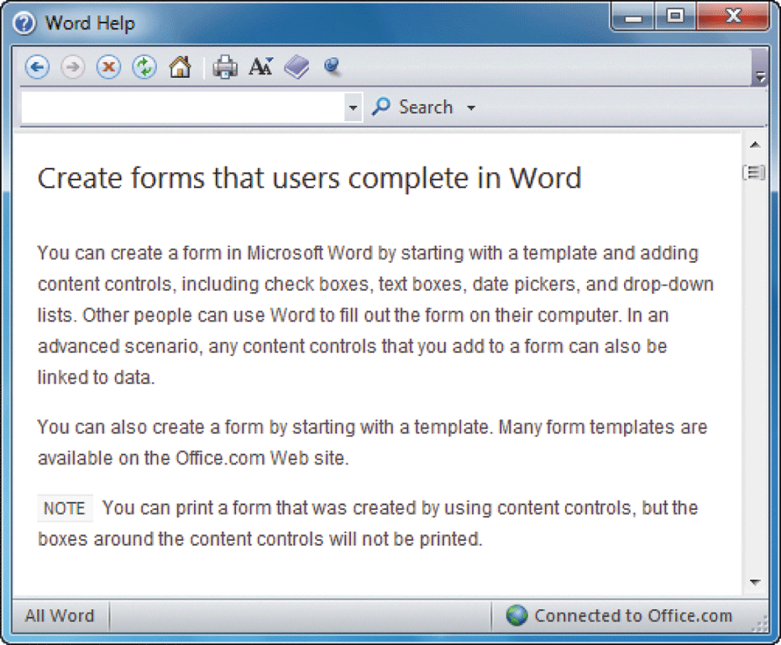
Other Fact-Finding Techniques
Questionnaires and Surveys
When designing a questionnaire, the most important rule of all is to make sure that your questions collect the right data in a form that you can use to further your fact-finding
Fill-in form

Slide 42
Other Fact-Finding Techniques
Sampling
Systematic sample
Stratified sample
Random sample
Main objective of a sample is to ensure that it represents the overall population accurately

Slide 43

Other Fact-Finding Techniques
Research
Can include the Internet, IT magazines, and books to obtain background information, technical material, and news about industry trends and developments
Site visit

Slide 44
Other Fact-Finding Techniques
Interviews versus Questionnaires
Interview is more familiar and personal
Questionnaire gives many people the opportunity to provide input and suggestions
Brainstorming
Structured brainstorming
Unstructured brainstorming

Slide 45
Documentation
The Need for Recording the Facts
Record information as soon as you obtain it
Use the simplest recording method
Record your findings in such a way that they can be understood by someone else
Organize your documentation so related material is located easily

Slide 46
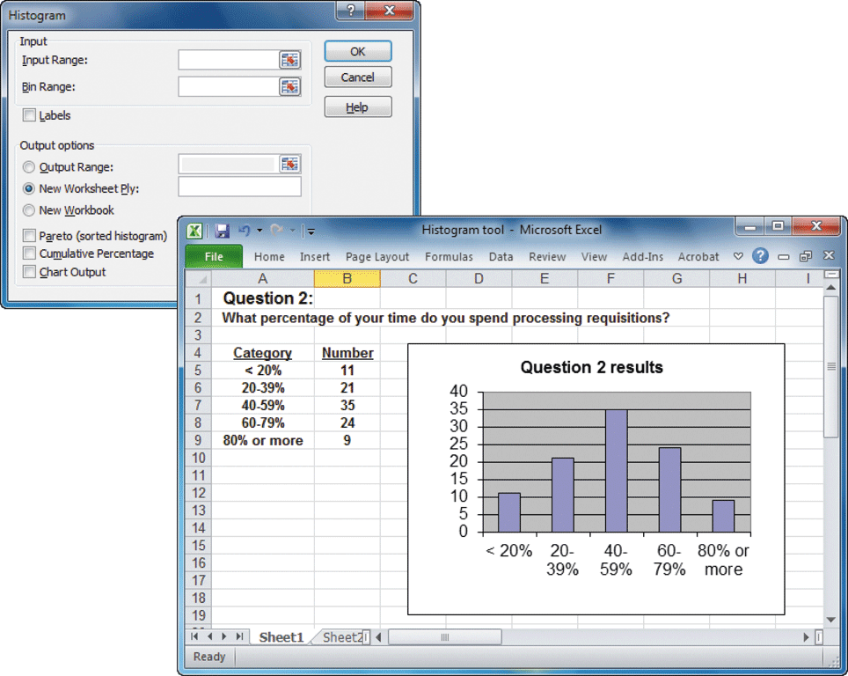
Documentation
Software Tools
CASE Tools
Productivity Software
Word processing, spreadsheets, database management, presentation graphics, and collaborative software programs
Histogram

Slide 47
Documentation
Software Tools
Graphics modeling software
Personal information managers
Wireless communication devices

Slide 48
Preview of Logical Modeling
At the conclusion of requirements modeling, systems developers should have a clear understanding of business processes and system requirements
The next step is to construct a logical model of the system
IT professionals have differing views about systems development methodologies, and no universally accepted approach exists

Slide 49
Chapter Summary
The systems analysis phase includes three activities: requirements modeling, data and process modeling, and consideration of development strategies
The main objective is to understand the proposed project, ensure that it will support business requirements, and build a solid foundation for the systems design phase

Slide 50
Chapter Summary
The fact-finding process includes interviewing, document review, observation, questionnaires, sampling, and research
Systems analysts should carefully record and document factual information as it is collected, and various software tools can help an analyst visualize and describe an information system
Chapter 4 complete

